Slide 1
Notes:
Topics:
Introduction to File Input and Output
Using Loops to Process Files
Processing Records
Exceptions

Slide 2
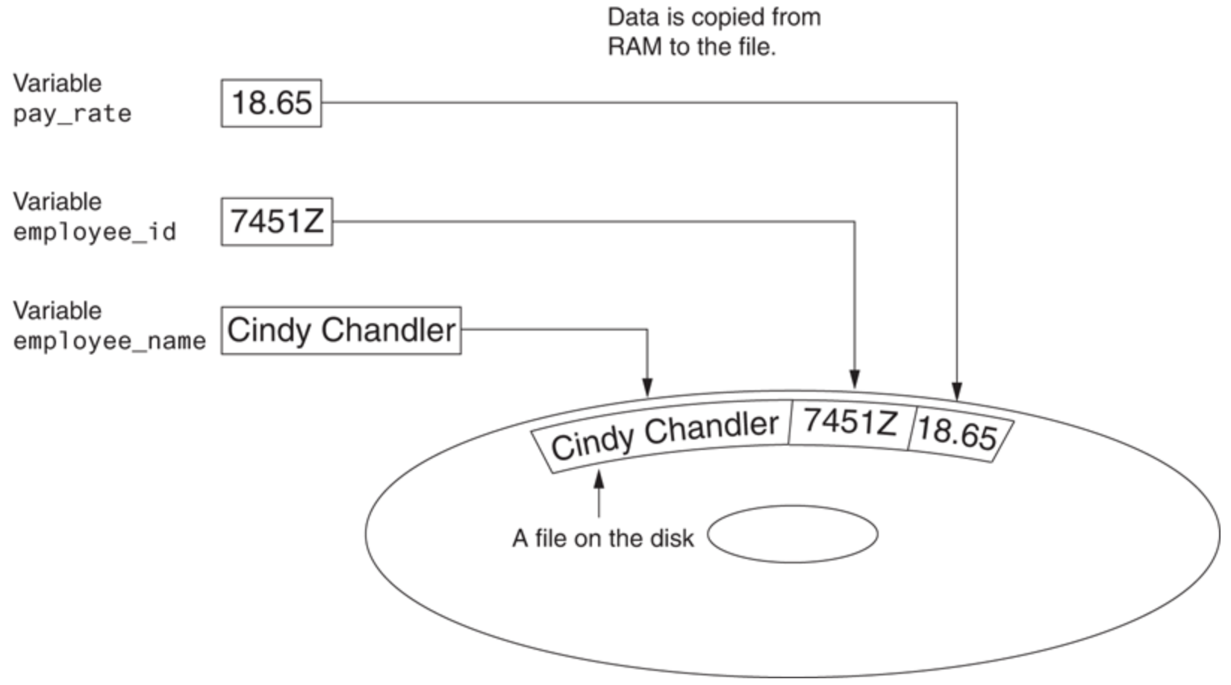
Introduction to File Input and Output
For program to retain data between the times it is run, you must save the data
“Writing data to”: saving data on a file
Output file: a file that data is written to
Notes:
Data is saved to a file, typically on computer disk
Saved data can be retrieved and used at a later time

Slide 3
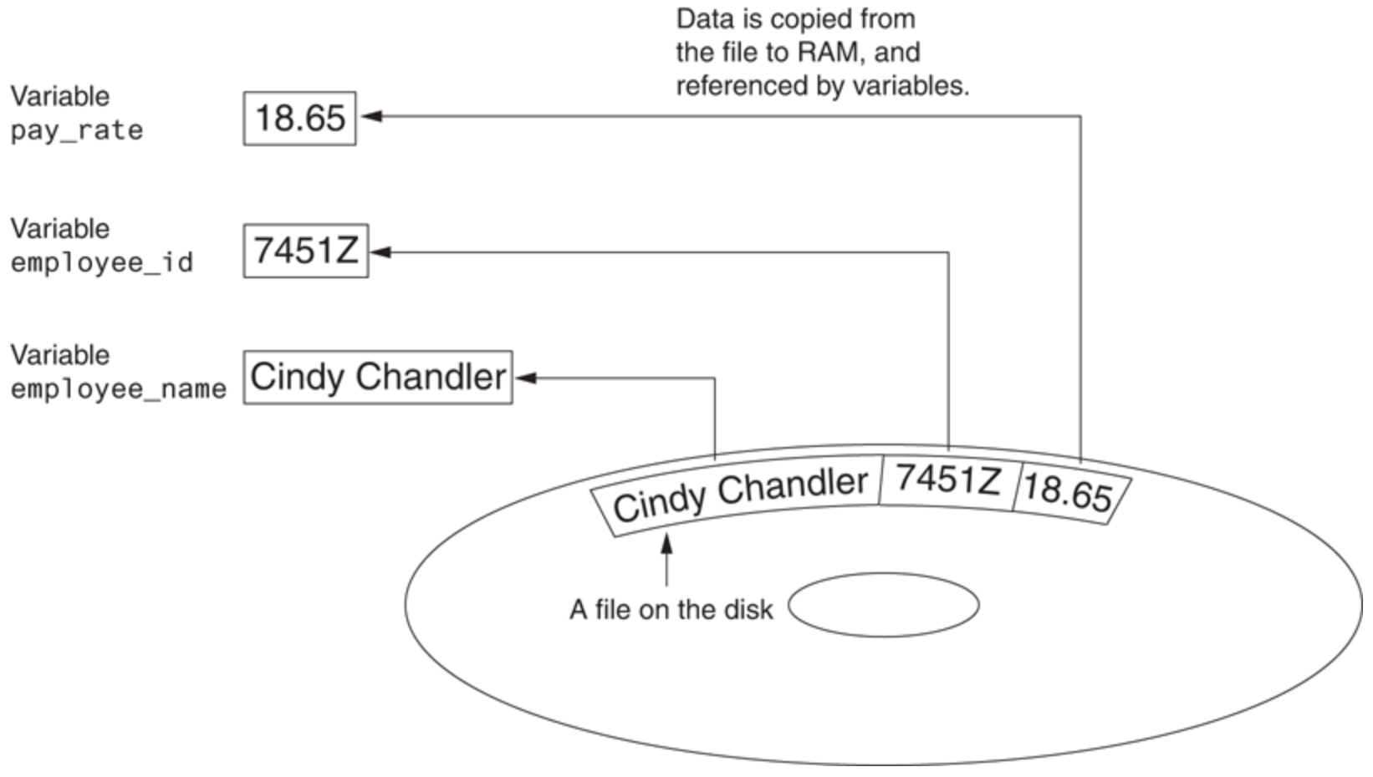
Introduction to File Input and Output (cont’d.)
“Reading data from”: process of retrieving data from a file
Input file: a file from which data is read

Slide 4
When a File Is Used…
Three steps when a program uses a file
Open the file
Process the file
Close the file
Notes:
Open the file. Opening a file creates a connection between the file and the program. Opening an output file usually creates the file on the disk and allows the program to write data to it. Opening an input file allows the program to read data from the file.
Process the file. In this step, data is either written to the file (if it is an output file) or read from the file (if it is an input file).
Close the file. When the program is finished using the file, the file must be closed. Closing a file disconnects the file from the program.

Slide 5
Types of Files and File Access Methods
In general, two types of files
Text file: contains data that has been encoded as text
Binary file: contains data that has not been converted to text
Two ways to access data stored in file
Sequential access: file read sequentially from beginning to end, can’t skip ahead
Direct access: can jump directly to any piece of data in the file
Notes:
A text file contains data that has been encoded as text, using a scheme such as ASCII or Unicode. Even if the file contains numbers, those numbers are stored in the file as a series of characters. As a result, the file may be opened and viewed in a text editor such as Notepad. A binary file contains data that has not been converted to text. The data that is stored in a binary file is intended only for a program to read. As a consequence, you cannot view the contents of a binary file with a text editor.
When you work with a sequential access file, you access data from the beginning of the file to the end of the file. If you want to read a piece of data that is stored at the very end of the file, you have to read all of the data that comes before it—you cannot jump directly to the desired data. This is similar to the way older cassette tape players work. If you want to listen to the last song on a cassette tape, you have to either fast-forward over all of the songs that come before it or listen to them. There is no way to jump directly to a specific song.
When you work with a direct access file (which is also known as a random access file), you can jump directly to any piece of data in the file without reading the data that comes before it. This is similar to the way a CD player or an MP3 player works. You can jump directly to any song that you want to listen to.

Slide 6
Filenames and File Objects
Filename extensions: short sequences of characters that appear at the end of a filename preceded by a period
Extension indicates type of data stored in the file
File object: object associated with a specific file
Provides a way for a program to work with the file: file object referenced by a variable

Slide 7
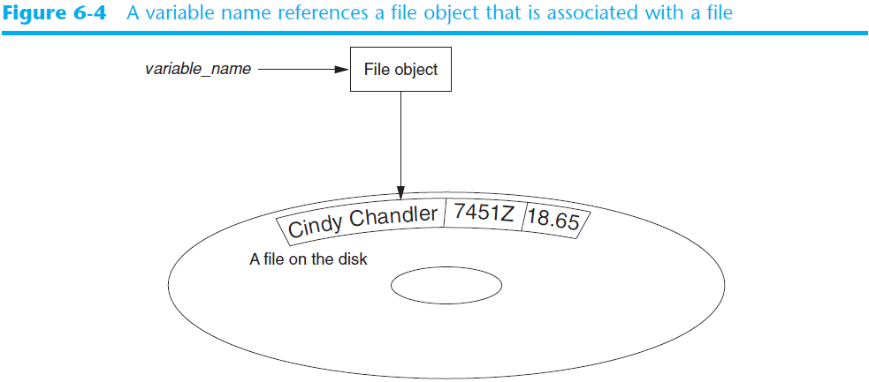
Filenames and File Objects (cont’d.)

Slide 8
Opening a File
open function: used to open a file
Creates a file object and associates it with a file on the disk
General format:
file_variable = open(filename, mode)
Mode: string specifying how the file will be opened
Example: reading only ('r'), writing ('w'), and appending ('a')

Slide 9

Specifying the Location of a File
If open function receives a filename that does not contain a path, assumes that file is in same directory as program
If program is running and file is created, it is created in the same directory as the program
Can specify alternative path and file name in the open function argument
Prefix the path string literal with the letter r
test_file = open(r'C:\Users\Carol\Desktop\Python\test.txt', 'w')
Notes:
This statement creates the file test.txt in the folder C:\Users\Carol\Desktop\Python. The r prefix specifies that the string is a raw string. This causes the Python interpreter to read the backslash characters as literal backslashes. Without the r prefix, the interpreter would assume that the backslash characters were part of escape sequences, and an error would occur.

Slide 10
Writing Data to a File
Method: a function that belongs to an object
Performs operations using that object
File object’s write method used to write data to the file
Format: file_variable.write(string)
File should be closed using file object close method
Format: file_variable.close()

Slide 11
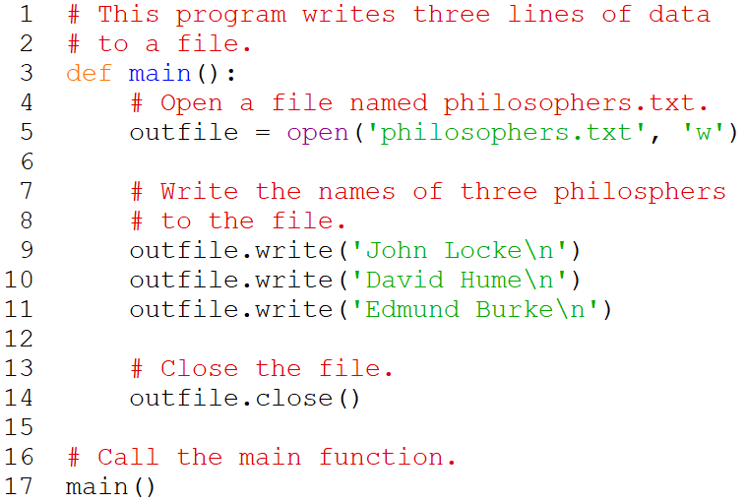
Writing Data to a File - Example

Slide 12
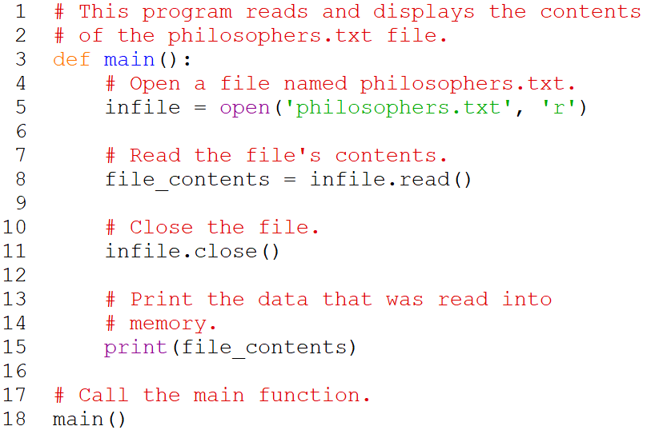
Reading Data From a File
read method: file object method that reads entire file contents into memory
Only works if file has been opened for reading
Contents returned as a string

Slide 13
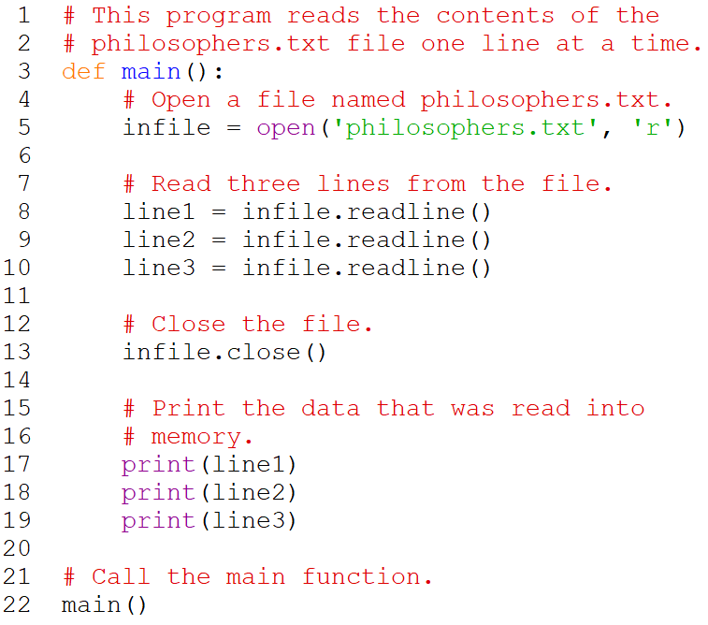
Reading Data From a File (cont’d.)
readline method: file object method that reads a line from the file
Line returned as a string, including '\n'
Read position: marks the location of the next item to be read from a file

Slide 14
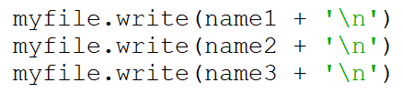
Concatenating a Newline to a String
In most cases, data items written to a file are values referenced by variables
Usually necessary to concatenate a '\n' to data before writing it
Carried out using the + operator in the argument of the write method
Notes:
Ensures each piece of data is written to a separate line

Slide 15
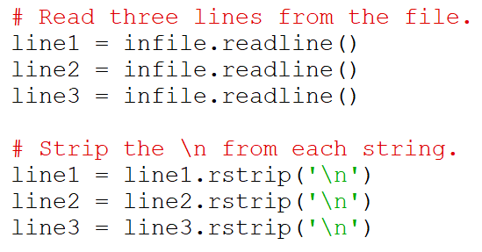
Stripping Newline from String
In many cases need to remove '\n' from string after it is read from a file
rstrip method: string method that strips specific characters from end of the string
Notes:
Extra blank lines do not appear in the output

Slide 16
Appending Data to an Existing File
When open file with 'w' mode, if the file already exists, it is overwritten
To append data to a file, use the 'a' mode
If file exists, it is not erased, and if it does not exist, it is created
Data is written to the file at the end of the current contents

Slide 17
Writing and Reading Numeric Data
Numbers must be converted to strings before they are written to a file
str function: converts value to string
Numbers are read from a text file as strings
Must be converted to numeric type in order to perform mathematical operations
Use int and float functions to convert string to numeric value

Slide 18
Using Loops to Process Files
Files typically used to hold large amounts of data
Loop typically involved in reading from and writing to a file
Often the number of items stored in file is unknown
The readline method uses an empty string as a sentinel when end of file is reached
Can write a while loop with the condition
while line != ''

Slide 19
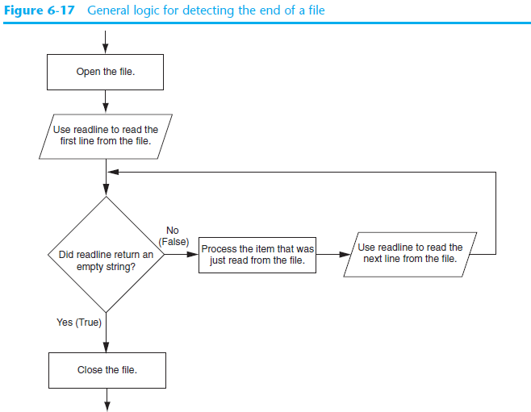

Slide 20
Using Python’s for Loop to Read Lines
Python allows the programmer to write a for loop that automatically reads lines in a file and stops when end of file is reached
Format: for line in file_object:
statements
The loop iterates once over each line in the file

Slide 21
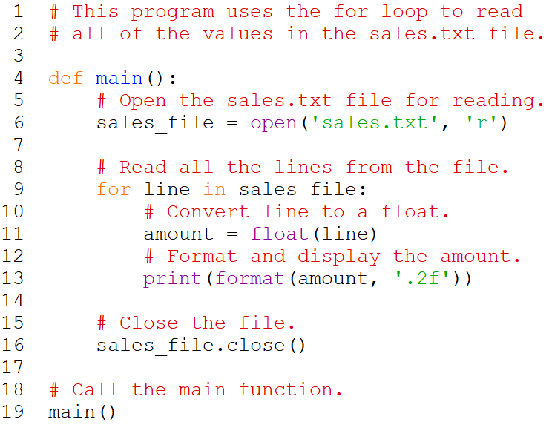
for Loop to Read Lines - Example

Slide 22
Knowledge Check
1. Assume we have a file called data.txt which contains many lines of text. Write a short program using the while loop that displays each line in the file.
2. Rewrite the program in #1 to use a for loop instead of a while loop.
Notes:
Problem #1:
infile = open(‘data.txt’, ‘r’)
line = infile.readline()
while line != ‘’:
print(line)
line = infile.readline()
infile.close()
Problem #2:
infile = open(‘data.txt’, ‘r’)
for line in infile:
print(line)
infile.close()

Slide 23
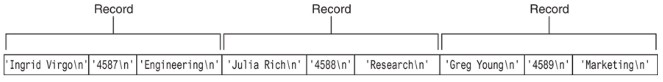
Processing Records
Record: set of data that describes one item
Field: single piece of data within a record
Write record to sequential access file by writing the fields one after the other
Read record from sequential access file by reading each field until record complete
Notes:
When working with records, it is also important to be able to:
Add records
Display records
Search for a specific record
Modify records
Delete records

Slide 24
Exceptions
Exception: error that occurs while a program is running
Usually causes program to abruptly halt
Traceback: error message that gives information regarding line numbers that caused the exception
Indicates the type of exception and brief description of the error that caused exception to be raised

Slide 25
Exceptions (cont’d.)
Many exceptions can be prevented by careful coding
Example: input validation
Usually involves a simple decision construct
Some exceptions cannot be avoided by careful coding
Examples
Trying to convert non-numeric string to an integer
Trying to open for reading a file that doesn’t exist

Slide 26
Exceptions (cont’d.)
Exception handler: code that responds when exceptions are raised and prevents program from crashing
In Python, written as try/except statement
General format: try:
statements
except exceptionName:
statements
Try suite: statements that can potentially raise an exception
Handler: statements contained in except block

Slide 27
Exceptions (cont’d.)
If statement in try suite raises exception:
Exception specified in except clause:
Handler immediately following except clause executes
Continue program after try/except statement
Other exceptions:
Program halts with traceback error message
If no exception is raised, handlers are skipped

Slide 28
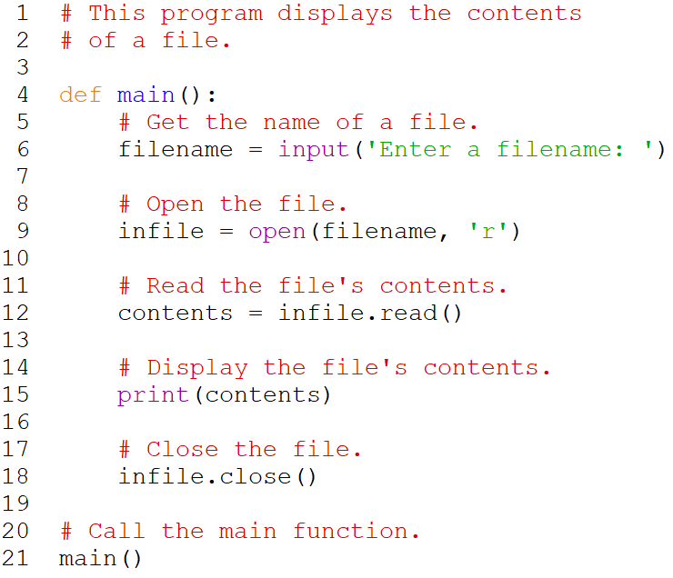
Exceptions Example
An okay program…with flaws
Notes:
This program, which does not use exception handling, gets the name of a file from the user then displays the contents of the file. The program works as long as the user enters the name of an existing file. An exception will be raised, however, if the file specified by the user does not exist. This is what happened in the sample run.
The statement in line 9 raised the exception when it called the open function. Notice in the traceback error message that the name of the exception that occurred is IOError. This is an exception that is raised when a file I/O operation fails. You can see in the traceback message that the cause of the error was No such file or directory: 'bad_file.txt'.

Slide 29
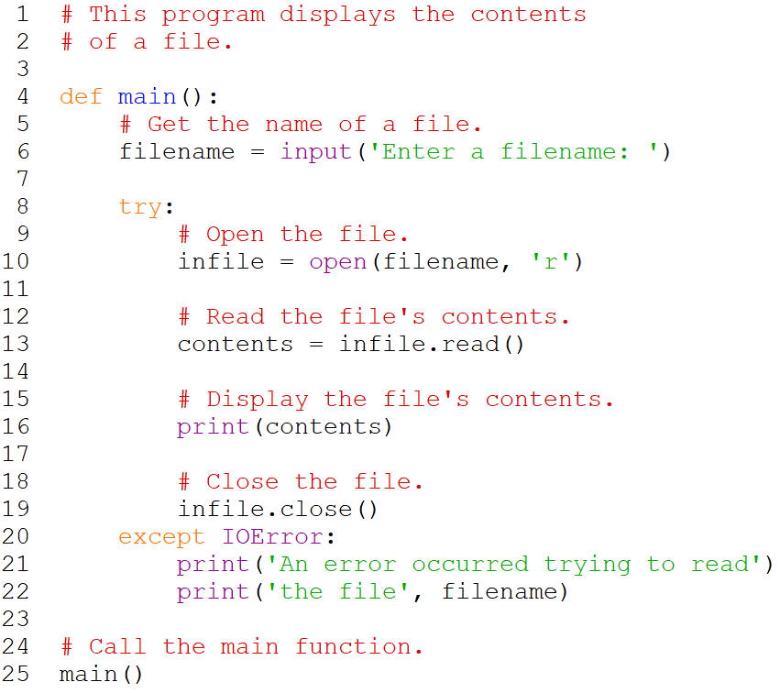
Exceptions Example (cont’d.)
A better program
Notes:
A modified program with a try/except statement that gracefully responds to an IOError exception. In the sample run, assume the file bad_file.txt does not exist.
Let’s look at what happened in the sample run. When line 6 executed, the user entered bad_file.txt, which was assigned to the filename variable. Inside the try suite, line 10 attempts to open the file bad_file.txt. Because this file does not exist, the statement raises an IOError exception. When this happens, the program exits the try suite, skipping lines 11 through 19. Because the except clause in line 20 specifies the IOError exception, the program jumps to the handler that begins in line 21.

Slide 30
Handling Multiple Exceptions
Often code in try suite can throw more than one type of exception
Need to write except clause for each type of exception that needs to be handled
An except clause that does not list a specific exception will handle any exception that is raised in the try suite
Should always be last in a series of except clauses

Slide 31
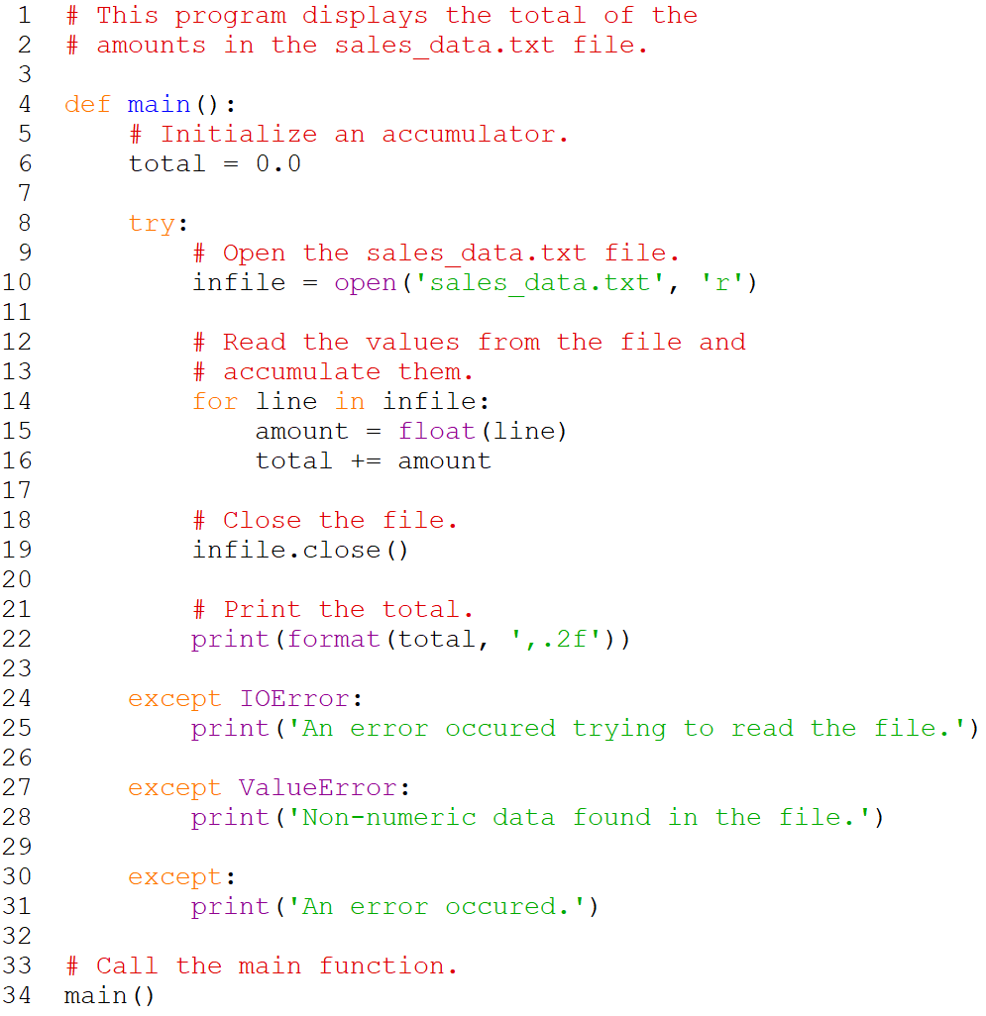
Handling Multiple Exceptions - Example
Notes:
The try suite contains code that can raise different types of exceptions. For example:
The statement in line 10 can raise an IOError exception if the sales_data.txt file does not exist. The for loop in line 14 can also raise an IOError exception if it encounters a problem reading data from the file.
The float function in line 15 can raise a ValueError exception if the line variable references a string that cannot be converted to a floating-point number (an alphabetic string, for example).
Notice the try/except statement has three except clauses:
The except clause in line 24 specifies the IOError exception. Its handler in line 25 will execute if an IOError exception is raised.
The except clause in line 27 specifies the ValueError exception. Its handler in line 28 will execute if a ValueError exception is raised.
The except clause in line 30 does not list a specific exception. Its handler in line 31 will execute if an exception that is not handled by the other except clauses is raised.

Slide 32

Displaying an Exception’s Default Error Message
Exception object: object created in memory when an exception is thrown
Usually contains default error message pertaining to the exception
Can assign the exception object to a variable in an except clause
Example: except ValueError as err:
Can pass exception object variable to print function to display the default error message

Slide 33
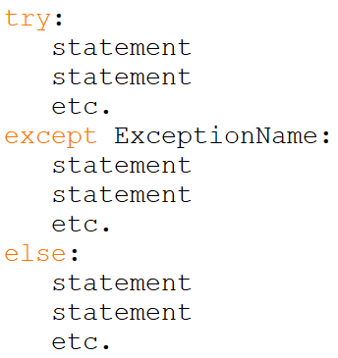
The else Clause
try/except statement may include an optional else clause, which appears after all the except clauses
Else suite: block of statements executed after statements in try suite, only if no exceptions were raised
If exception was raised, the else suite is skipped
Notes:
Aligned with try and except clauses
Syntax similar to else clause in decision structure

Slide 34
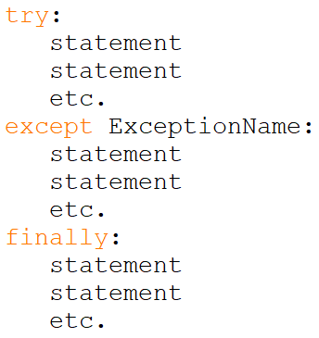
The finally Clause
try/except statement may include an optional finally clause, which appears after all the except clauses
Finally suite: block of statements after the finally clause
Execute whether an exception occurs or not
Purpose is to perform cleanup before exiting
Notes:
Aligned with try and except clauses
The block of statements that appears after the finally clause is known as the finally suite. The statements in the finally suite are always executed after the try suite has executed, and after any exception handlers have executed. The statements in the finally suite execute whether an exception occurs or not. The purpose of the finally suite is to perform cleanup operations, such as closing files or other resources. Any code that is written in the finally suite will always execute, even if the try suite raises an exception.

Slide 35
What If an Exception Is Not Handled?
Two ways for exception to go unhandled:
No except clause specifying exception of the right type
Exception raised outside a try suite
In both cases, exception will cause the program to halt
Python documentation provides information about exceptions that can be raised by different functions

Slide 36
Summary
This chapter covered:
Types of files and file access methods
Filenames and file objects
Writing data to a file
Reading data from a file and determining when the end of the file is reached
Processing records
Exceptions, including:
Traceback messages
Handling exceptions

